Slide 1
Aviation Fuel
Aviation fuels are petroleum-based fuels that power aircraft. They are more stringent heating and road transport fuels, and contain additives to improve or maintain fuel performance and handling.
Here are some types of aviation fuels:
AVGAS
Aviation gasoline is used by small private aircraft and older propeller planes. It works well for aircraft with engines that require leaded fuel and a high-octane number.
Jet A
A common aviation fuel used in commercial aircraft powered by gas turbines.
Jet B
A common alternative to jet fuel and AVGAS, primarily used in civil aviation. Jet B has a low freezing point of -76° C, making it useful in extremely cold areas.
Jet fuel
Also known as aviation turbine fuel (ATF), jet fuel is a type of highly refined kerosene. It has a higher energy density than other fuels, allowing for better fuel efficiency and longer flights.
Biokerosene
A type of biofuel that replaces aviation kerosene. It is produced from vegetable oils, animal fats, urban waste, and other biofuels.

Slide 2
Alternative Aviation Fuels
Currently, aviation mainly uses jet fuels including Jet A-1, Jet A (only US), JP-5, and JP-8 (military aircraft), although Jet B and JP-4 are also used as blends of kerosene-naphtha and kerosene-gasoline. Aviation also uses a small amount of aviation gasoline (Avgas), a residual lead-blended aviation fuel, mainly used in reciprocating-engine or piston-engine aircraft.
Bio-jet fuels
Similarly, low blending of bio-jet fuels with conventional jet fuel reduces exhaust toxicity. The energy content (by weight) and other fuel properties of bio-jet fuels are rather like those of conventional jet fuel, which aids adoption in existing engines.
Electro-jet fuels
Electro fuels are primarily produced from electricity via electrolysis of water with the use of captured carbon (or nitrogen), forming, for example, Fischer-Tropsch kerosene, methane, methanol, hydrogen, ammonia, and n-octane.
Ammonia
Ammonia (NH3) is perceived as a potential fuel for gas turbines as it has a high H2 content but not any carbon atoms. Ammonia, mixed with H2 or LCH4, can be used as aviation fuel in low blending or as a dual fuel solution in modified aircraft engines and fuel cells.

Slide 3
Liquefied methane
The studies and experimental tests have shown that LNG is a viable option as an alternative aviation fuel; however, it is not used in normal service and operations. The main energy carrier in LNG is methane, which can also be produced from biomass pathways (e.g., liquefied biogas) and electrofuels pathways. However, several challenges remain in operating LCH4 aircraft, where design and construction of the LCH4 storage tanks and supply chain infrastructure are the biggest challenges. Cryogenic fuel tanks are required to operate LCH4 in an aircraft; these are larger and heavier than other fuel tanks.
Hydrogen
H2 is perceived as an attractive alternative aviation fuel both in recent and past research as it has a great supply potential, contains three times the energy content per weight of traditional jet kerosene (43.2 MJ/kg vs 120 MJ/kg respectively) and does not produce CO2 from combustion. It is flammable, has a very short ignition time in comparison to conventional jet fuel, and provides a wider stability range. It has the highest thermal conductivity among all fuels, and high heat capacity and low dynamic viscosity, which provide superior cooling properties for operation at high speeds and high combustor temperatures.

Slide 4
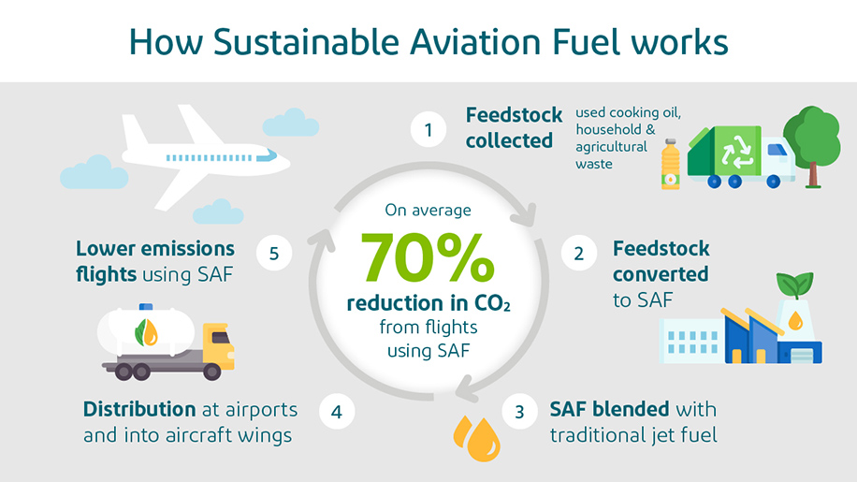
Sustainable Aviation Fuels
Sustainable aviation fuels (SAFs) fall into two categories: carbon neutral drop-in (e.g. synthetic or bio fuels) and non-carbon neutral (e.g., hydrogen). Carbon neutral drop-in results in low (or net-zero) CO2 emissions, while carbon zero (zero-carbon hydrogen) results in no CO2 emissions at all. In the future, photovoltaic (PV) and wind power will enable large-scale production of 'green' hydrogen, significantly reducing carbon emissions and providing an attractive storage option.

Slide 5
HYDROGEN

Slide 6
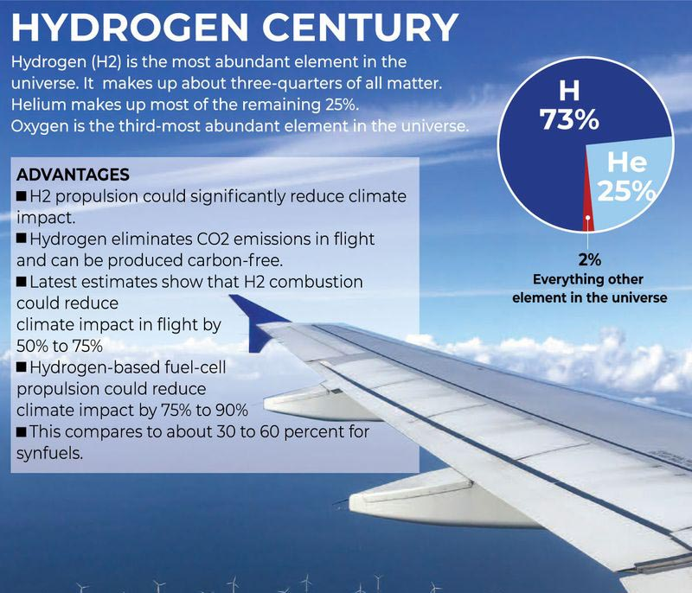
Hydrogen can be used as an aircraft fuel instead of the aviation fuel, jet fuel.
Hydrogen is sustainable fuel if it will produce by nature resources. Hydrogen is a good choice for aircraft fuel, but there are many problems to be faced. Here we have discussed about the aviation fuel, sustainable aviation fuel, hydrogen as fuel and problems to face and some solutions.

Slide 7
A hydrogen-powered aircraft is an airplane that uses hydrogen fuel as a power source. Hydrogen can either be burned in a jet engine or can be used to power a fuel cell to generate electricity to power a propeller.
Hydrogen is classified as "gray" if it is produced using fossil fuels, "blue" if those emissions are captured or offset, and "green" if it is generated by renewable energy with no carbon emissions.
Hydrogen can be used as fuel for aircraft in two ways:
Fuel cells: Hydrogen can power electric motors in fuel cells, or be used in adapted gas turbine engines. Hydrogen fuel cells can eliminate CO2 emissions during flight and throughout the energy life cycle if produced from renewable sources.
Combustion: Hydrogen can be combusted in adapted gas turbine engines
Hydrogen can either be burned in a jet engine or another kind of internal combustion engine, or can be used to power a fuel cell to generate electricity to power an electric propulsor. It cannot be stored in a traditional wet wing, and hydrogen tanks have to be housed in the fuselage or be supported by the wing.

Slide 8
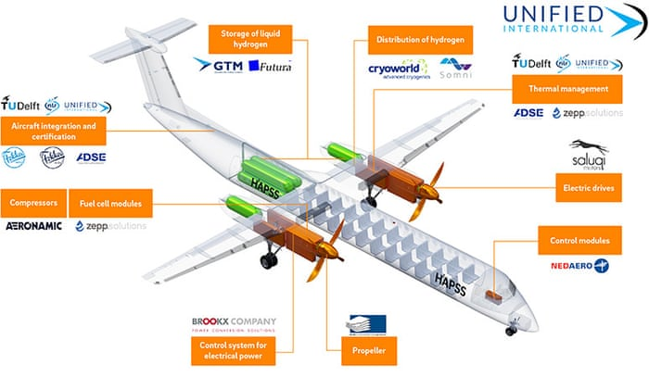

Slide 9
The Advantages of Hydrogen Propulsion
The advantages of hydrogen as a fuel for aircraft are astonishing:
It is lightweight
It does not generate CO2
It can be generated anywhere it is needed
Refueling times are short
Lack of CO2 generation
When talking about the context in which hydrogen propulsion is used, there are two main use cases:
Hydrogen aero engine: Substituting the aviation fuel with hydrogen, hence burning it. The combustion of hydrogen does not generate carbon dioxide.
Hydrogen fuel cell: Using hydrogen to feed a fuel cell would generate electricity used by electric motors to power the aircraft propellers or fans. In such a system, the fuel cell would generate electricity and water.
In neither case is carbon dioxide generated. Both would lead to substantial improvements in greenhouse emissions.

Slide 10
Lightweight
Hydrogen’s energy density is about three times higher than jet fuel. This means that, for the same amount of energy, hydrogen would be three times lighter to transport in an aircraft than jet fuel. This is a remarkable difference from some concepts in the current technology pipeline, namely the full and hybrid electric ones.
Generation wherever needed
Contrary to jet fuel which requires oil extraction in fewer places, is harder to access, and has complex refinement, hydrogen can be generated anywhere there is water, electricity, and an electrolyzer. Hydrogen can be generated near its consumption point – removing the need for long-distance transport.
Refueling time
Charging time for large battery packs is typically longer than refueling hydrogen tanks.

Slide 11
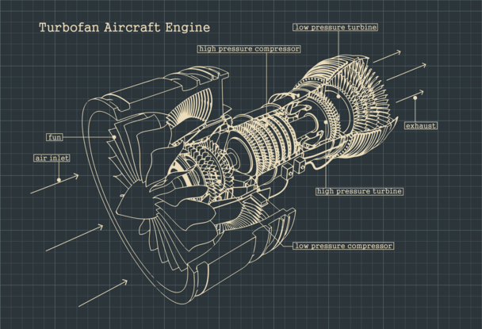
Engine:
Gas Turbine Engine is used
A hydrogen internal combustion engine differs from a hydrogen fuel cell. The fuel cells generate electricity from hydrogen and then use that electricity in an electric motor, much like an electric vehicle. Meanwhile, with internal combustion, hydrogen is used the same way as gasoline or jet fuel. Liquid or gaseous hydrogen is burned in a gas turbine engine to generate thrust.
Combustion is a chemical process in which energy is released from a mixture of fuel and air. Proponents of hydrogen say that its wide flammability range and high auto-ignition temperature make it particularly suitable for combustion. The former means it can be used with a lower temperature, creating fewer pollutants, while the latter means less energy loss.
https://www.airbus.com/en/newsroom/stories/2020-11-hydrogen-combustion-explained

Slide 12
Hydrogen-powered aircraft face several challenges, including:
Low volumetric density
Hydrogen is much lighter than jet fuel, so it has a lower volumetric density. This means that hydrogen-powered aircraft need four to five times the volume of conventional fuel to carry the same amount of energy.
Storage
Hydrogen is very low density at room temperature, so it requires large storage volumes and heavy tanks.
Safety
Hydrogen is highly flammable and explosive. As a gas, it's stored under high pressure, which could injure nearby personnel. As a cryogen, it could cause injuries like frostbite.
Transportation
Hydrogen is difficult to transport from one place to another.
Cost
Hydrogen can be generated by the hydrolysis of water, but it's a very expensive process.

Slide 13
Low volumetric density
As much as hydrogen’s energy density is high, its volumetric energy density is low. For a given amount of energy, hydrogen would occupy at least three times more volume than jet fuel in ambient conditions. To tackle this issue, two main streams are investigated:
Liquefying: Liquid hydrogen requires very low temperatures (~ -250°C), with the constraints that come with it like cold management, mechanical differential dilatations, and phase change.
Compressing: This requires pressures in the order of 700 bar (10,000 psi) to be attractive, which increases the leakage and reduces the lifetime of the mechanical parts.
So both the above solutions have their disadvantages. Thus we are going to use one of the above wat to solve the problem along with thinking about how to minimize the disadvantages.

Slide 14
Storage
Storage of hydrogen is one of the main problem. As hydrogen has low volumetric density, it requires more volume than jet fuel. To overcome the low volumetric density problem we store the hydrogen in liquid form, which requires very low temperature (around -250°C).
Handling a liquid at that kind of temperature is immensely challenging. Given the chance, liquid hydrogen will "boil-off" and escape as a gas - potentially becoming a hazard. So, tanks, pipes and hoses all have to be extra-insulated to keep the liquid cold
Unlike current planes, which can store fuel in their wings, hydrogen planes will have to store their fuel in the fuselage, cutting space for passengers.
As hydrogen planes will have to store their fuel in the fuselage, this result in the cutting space for passengers. Designing a fuel tank inside the plane which does not affect the space for passengers and also does not increase the weight of the aircraft and can store hydrogen at very low temperature.

Slide 15
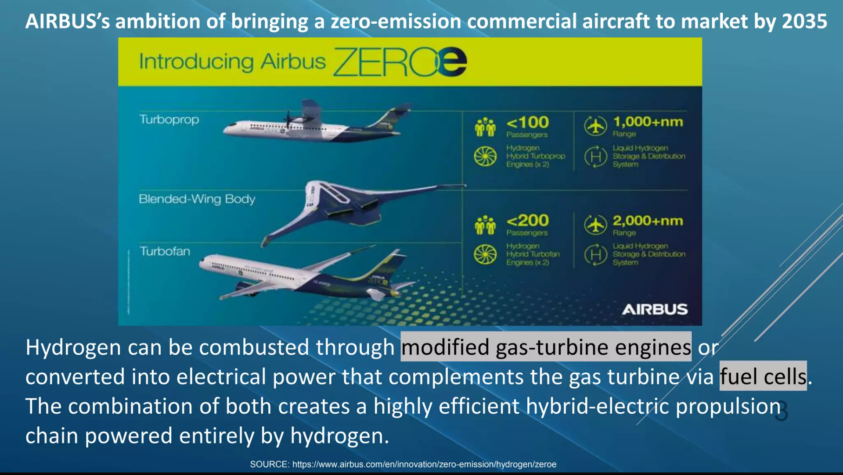

Slide 16
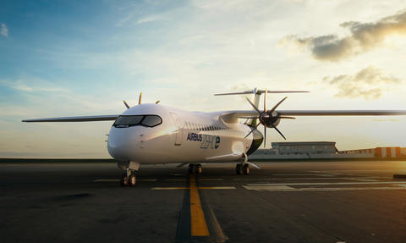
AIRBUS
Airbus SE is a European multinational aerospace corporation. The company consists of three core units. Its primary business is the design and manufacturing of commercial aircraft but it also has separate defense and space and helicopter divisions.
ZEROe
Towards the world’s first hydrogen-powered commercial aircraft

Slide 17
Airbus is meeting a number of technology and testing milestones as it moves towards its ambition of bringing to market a hydrogen-powered commercial aircraft by 2035.
Many of these milestones revolve around establishing the means of propulsion, either via hybrid hydrogen-electric fuel cells or direct hydrogen combustion. Airbus has even established a joint venture with automotive supplierElringKlinger AG, Airbus Aerostack, to develop hydrogen fuel cell stacks at the heart of an electric propulsion system.
Airbus is exploring both hydrogen-combustion and fuel-cell propulsion technologies, for which demonstrators have been launched. It has also set-up dedicated Development Centers in France, the UK, Germany and Spain to work on tanks and cryogenic fuel systems.
Airbus test aircraft A380 MSN1 is taking the lead in testing these technologies that will be vital to bringing a hydrogen-powered commercial aircraft to market.
https://www.airbus.com/en/innovation/low-carbon-aviation/hydrogen/zeroe

Slide 18
What we are going to do in this project:
• We have to think about a storage device that can store liquid
hydrogen at low temperature, because storage of liquid hydrogen is
one of the main problem.
• Also, we are going to think, how this can be made economical.
• As hydrogen planes will have to store their fuel in the fuselage, this
result in the cutting space for passengers. Designing a fuel tank
inside the plane which does not affect the space for passengers and
also does not increase the weight of the aircraft

